Slide 1
Toward disentangling causes for the substantial increase of CO₂ seasonal cycle amplitude in the Arctic
PI: Lei Hu (NOAA/CIRES)
Co-PIs & Co-Is: Arlyn Andrews (NOAA), Steve Montzka (NOAA), Kathryn McKain (NOAA/CIRES), John Miller (NOAA), John Henderson (AER)
Collaborators: Scott Denning (CSU), Ian Baker (CSU), Jim Abshire (NASA/GSFC)
Thanks to Colm Sweeney for helping with the development of this proposal and facilitating our interaction with other ABoVE projects.
Questions to lei.hu@noaa.gov

Slide 2
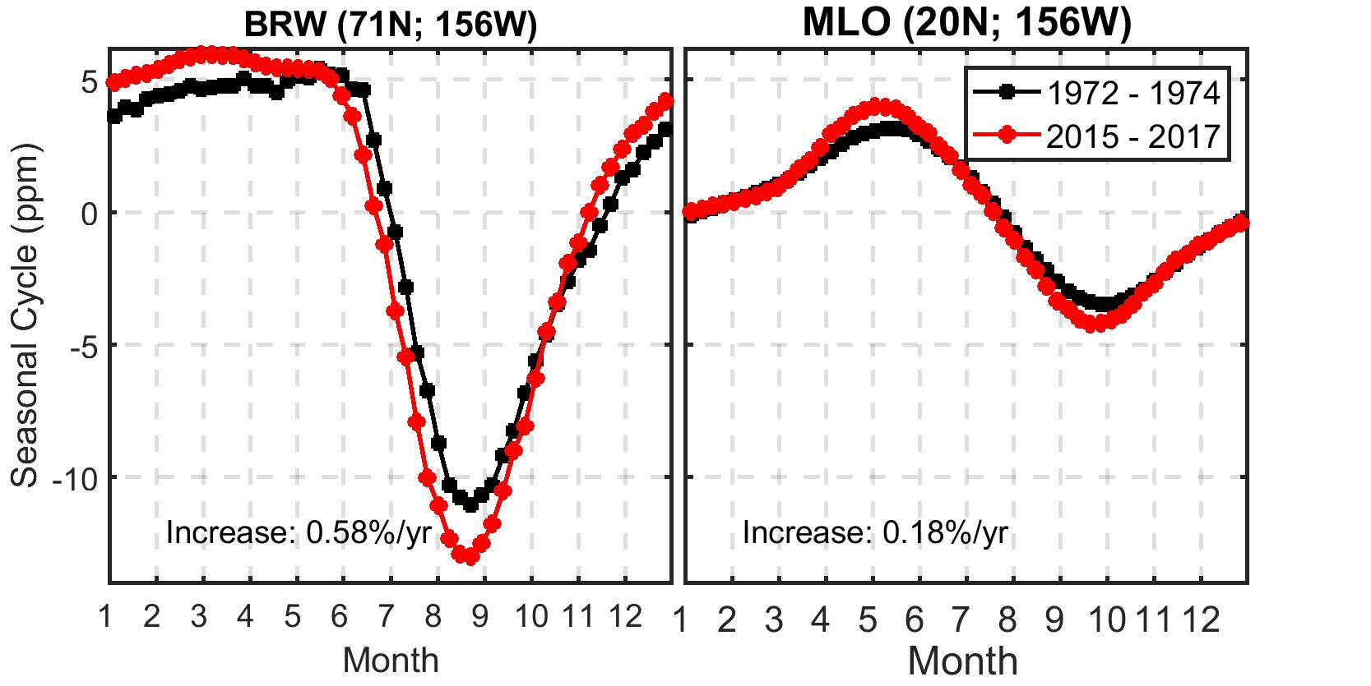
Increasing CO₂ Seasonal Cycle Amplitude (SCA)
Possible causes?
1972 – 1974
2015 - 2017

Slide 3
Project Goal and Scientific Objectives
Disentangle potential causes that resulted in enhanced CO₂ SCA in northern high latitudes
Separating and quantifying contributions of GPP and respiration from the Arctic ecosystems
The ABoVE region
2015 - 2019
Polar-VPRM
pan-Arctic
2000 onward
Using CO₂ and COS,
satellite products
Separating and quantifying contributions of mid-latitude v.s. high-latitude fluxes to the enhanced SCA
Using CarbonTracker

Slide 4
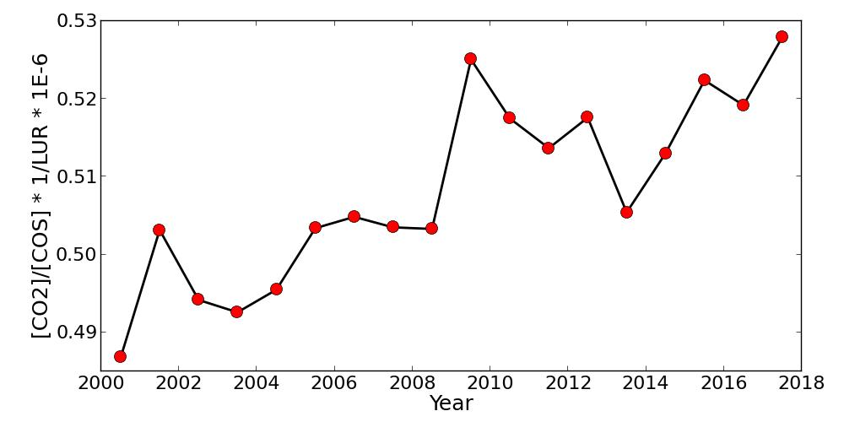
Uniqueness of Our Approach
We will use CO₂ and COS to partition GPP and respiration from NEE
$$GPP=\frac{F_{COS}}{LUR}∗\frac{[{CO}_{2}]}{[COS]}$$

Slide 5
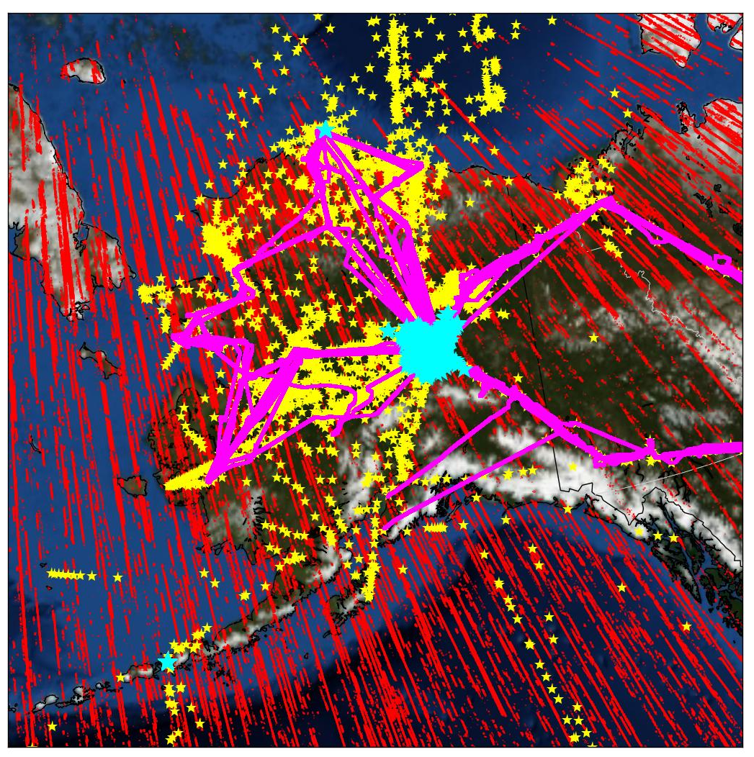
Uniqueness of Our Approach
We will use the most abundant observational datasets
ABoVE Region
- Atmospheric CO₂ and COS data from flasks, in situ, and satellites
Flask + In situ
ArcticCAP
ATom
CARVE
NSA
NOAA GGRN
Remote sensing
ASCENDS
OCO-2
- Satellite land-data products
SMAP soil moisture
TROPOMI SIF
MODIS NDVI
MODIS FPAR
MODIS GPP
MODIS land surface temperature
MODIS precipitable water
Flask sampling (campaign, long-term)
ABoVE in situ (ArcticCAP)
OCO2 (V9)

Slide 6
Uniqueness of Our Approach
We will use multiple modeling approaches, leveraging advantages of both regional and global models
Response of North American NEE to ENSO
0.1º regional inverse model – CarbonTracker-ABoVE
Satellite-data driven Polar-VPRM
CarbonTracker
Hu et al., Science Advances (in press)

